Slide 1

Time Series Analysis Using PySparkSQL on Azure Databricks
-Presented By
Vikas Reddy Gorantla
Sarthak Kulkarni
Seemalamudi Nikhil Sai
Page
01

Slide 2
Introduction
Overview
Objectives
Architecture And ER Diagram
AGENDA
Resource And Tools
Challenges
Results
Conclusion
Page
04

Slide 3

INTRODUCTION
Time Series Analysis involves analyzing time-ordered data points.
Applications include stock market prediction, sales forecasting, weather analysis, etc.
Key components:
Trend: Long-term movement in data.
Seasonality: Regular pattern or cycles in data.
Anomalies: Outliers or unexpected deviations.
Page
02

Slide 4




OVEVIEW
This project focuses on performing time series analysis using PySparkSQL on Azure Databricks to process and analyze large-scale time-stamped data.
The objective is to identify trends, detect seasonality, and spot anomalies within the data.
The project demonstrates the power of cloud-based analytics for deriving actionable insights from time series data, with potential for future enhancements like predictive modeling and real-time analysis.
Page
03

Slide 5

CHALLENGES
Handling large datasets efficiently.
Ensuring data quality and consistency.
Interpreting anomalies in real-world scenarios.
Page
05

Slide 6
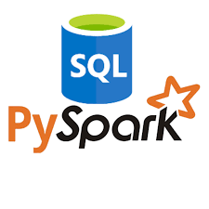
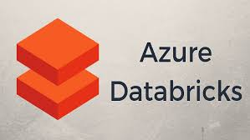
TOOLS AND RESOURCES
PySparkSQL:
Handles large-scale distributed data.
SQL-like syntax for data querying and transformation.
Azure Databricks:
Unified analytics platform optimized for Azure.
Built-in integration with Azure storage and machine learning.
Collaborative environment for data scientists and engineers.
Page
06

Slide 7

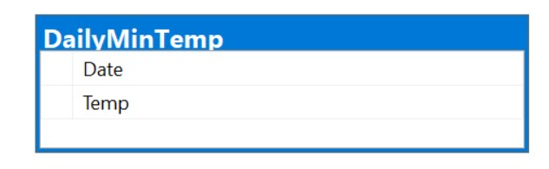

ARCHITECTURE
Data Ingestion: The raw CSV dataset is uploaded into Azure Databricks using DBFS.
Data Processing: PySparkSQL is used for trend, seasonality, and anomaly detection.
Trend Analysis: Moving averages identify long-term trends in passenger data.
Seasonality Detection: Monthly averages highlight seasonal patterns in passenger counts.
Visualization: Trends, seasonality, and anomalies are visualized in Databricks notebooks.
Anomaly Detection: Z-score method detects and flags outlier data points.
Insights Generation: Analysis reveals passenger trends, seasonality, and anomalies.
Workflow Execution: The workflow is executed seamlessly within Azure Databricks.
Data Storage: Data is stored in Delta Lake format for optimized storage and efficient querying.
.
Page
07

Slide 8
CONCLUSION
This project successfully demonstrates the use of PySparkSQL on Azure Databricks for efficient and scalable time series analysis.
Uncovered valuable insights such as long-term trends, seasonal patterns, and anomalies that can inform strategic decision-making.
The combination of PySparkSQL's distributed processing capabilities and Azure Databricks' collaborative environment proved to be an ideal solution for handling large scale data.
.
.
Page
08

Slide 9
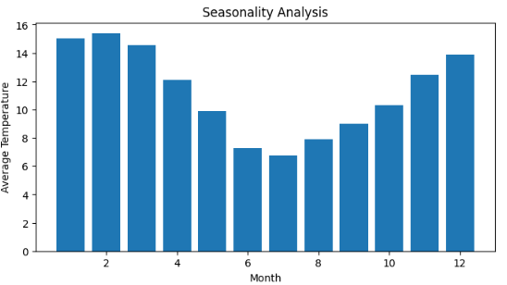
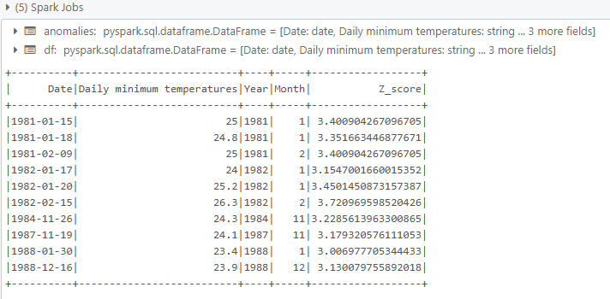
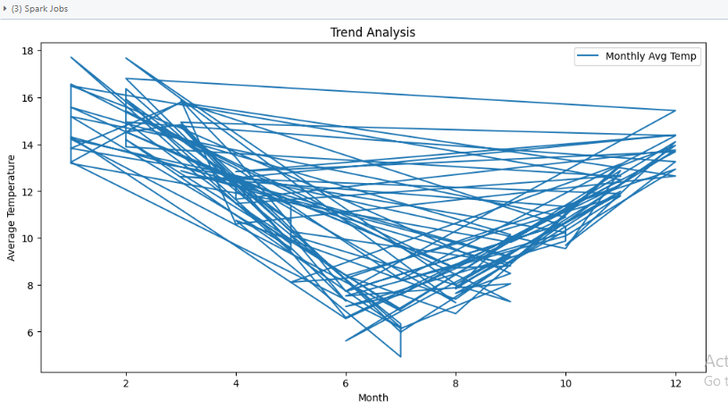
RESULTS
.
Page
09

Slide 10
Thank
You.
Page
10

